Slide 1
Date - a - Scientist
Machine Learning Fundamentals
Tara Jones
12th November 2018

Slide 2
Contents
Exploration of the dataset
Defining the question
Augmenting the dataset
Classification approaches
Regression Analysis
Further Analysis – KMeans Clustering
Conclusions/Next Steps

Slide 3
1. Exploring the dataset (1)
The dataset includes information on: body type, diet, drinks, drugs, education, ethnicity, height, income, job, offspring, orientation, religion, sex, sign, smokes, speaks, status, and includes ten essays covering the following subjects:
My self summary
What I’m doing with my life
I’m really good at
The first thing people usually notice about me
Favourite books, movies, show, music, and food
The six things I could never do without
I spend a lot of time thinking about
On a typical Friday night I am
The most private thing I am willing to admit
You should message me if…

Slide 4
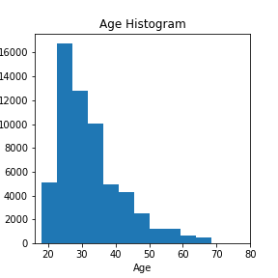
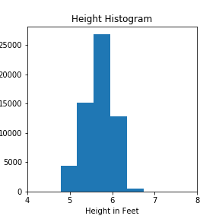
1. Exploring the dataset (2)
In the raw dataset, the average age is 32, the average height is 5ft 7 and the average income is US$ 104,394*.
Based on 20% of respondents (assumes answer o f -1 as not valid)

Slide 5
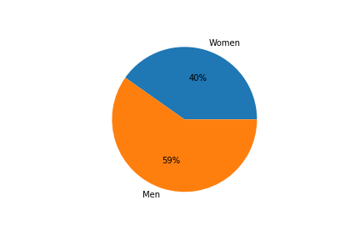
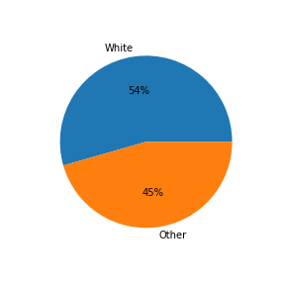
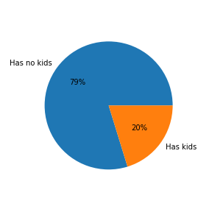
1. Exploring the dataset (3)
59% of the respondents are men, 54% are white, 36% speak English as their main language* and 80% have no kids
Assumes that speaks English fluently does not count as first language

Slide 6
2. Defining the Questions
I checked if education level could be predicted based essay text word counts using:
First, a Naïve Bayes classifier, which I then extended to other variables such as job, and education plus job; and then
K Nearest Neighbours, having converted education levels to a numerical counter
Then, I looked at whether age could be predicted based on the frequency of usage of "I" or "me" in the essay, using:
both Linear Regression and KNN regression to analyse relative results
Finally, I used age, drugs, drinks and smokes in KMeans clustering to help refine the questions

Slide 7
3. Augmenting the dataset (1)
For the Naive Bayes Classification analysis on the first question,
I added a word count column by first having combined the essays together, removing alls NaN, all punctuation elements, breaks and whitespaces
In order to tag the dataset, I created an index based on the median word count, where high usage I tagged as [1] and included anything above the median.
I then created a cleaned education and job columns having removed NaNs
For the K Nearest Neighbors classification:
I add an education level counter, where I ranked:
space camp: 8, PhD: 7, med school and law school: 6, masters: 5, university/college:, 4, two-year college: 3, high school: 2
Adjusted for graduated (+1) or dropped-out (-1)

Slide 8
3. Augmenting the dataset (2)
For the linear regression analysis on the second question:
From the combined and cleaned all essays, added a column for the frequency of “I” and another for frequency of “me”
Normalised the dataset using a min-max scaler from the pre-processing library
For the KNN regression :
In order to tag the dataset, I created an index based on the frequency of usage of “I” where high usage I tagged as [1] and included anything above the median
Normalised the dataset using a standard pre-processing scaler
For the KMeans clustering:
I mapped the drugs, smokes and drinks columns into indexed columns

Slide 9
4. Classification approaches (1)
First using Naïve Bayes classification to predict education level with essay text word counts. I also compared with job. And the combination of job and education. The classifier predict function (not shown) was limited
 | Education using word count | Job using word count | Education and job using word count
Accuracy | 49.32% | 51.04% | 51.40%
Recall | 77.41% | 61.93% | 50.95%
Precision | 49.01% | 50.15% | 50.55%
F1 score | 60.02% | 55.42% | 51.25%
Confusion matrix | [[1351 4746] [1331 4562]] | [[2470 3627] [2243 3650]] | [[3102 2995] [2831 3062]]

Slide 10
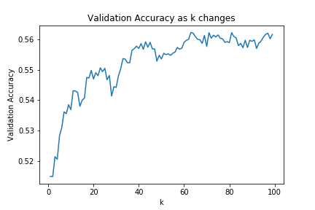
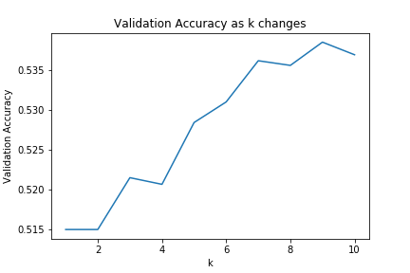
5. Classification approaches (2)
Using K-Nearest Neighbors to check if education levels can be predicted with word count, having adjusted k to 7, which from analysis seems the best fit, accuracy improved from 52.8% to 53.6%.

Slide 11
4. Classification approaches (3)
Comparing the two classification methodologies:
 | Naïve Bayes | KNN
Simplicity | Much simpler to set up, as less data preparation required for string inputs | Setting-up the data to run the classification is more timely and complex as special counters had to be created
Time to run model (s) | 0.06 – 0.09 | 0.70-0.90*
Accuracy | 49.32 – 51.4% | 52.8% - 53.6%
Precision, F1 score, recall, confusion matrix | Recall at 77% was excellent, Precision at 49% ok and F1score at 60% was good, as was confusion matrix [[1351 4746] [1331 4562]] | Not applicable
Conclusion | Good technique to use as a first iteration on the data | For a more accurate reading of what the data is telling us KNN is perhaps more useful, but this takes longer to run and prepare
* Excluding time to run short k validation accuracy graph, which was long for a k up to 100 at 90s

Slide 12
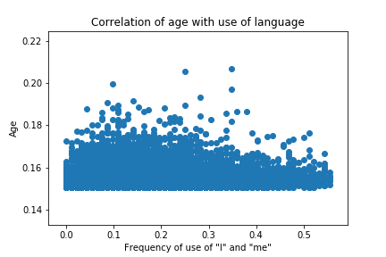
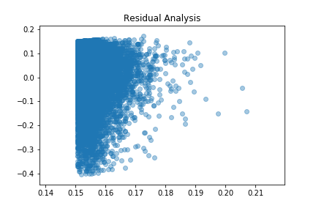
5. Regression analysis (1)
The linear regression to predict age depending on the on the frequency of the usage of "I" or "me“ in all essays took 0.60 seconds to run, with coefficient of [0.10707377, 0.01528606], train score of: 0.123 and test score of 0.239.

Slide 13
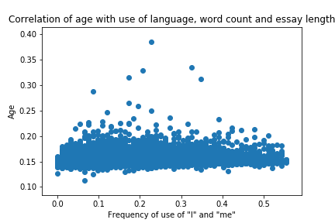
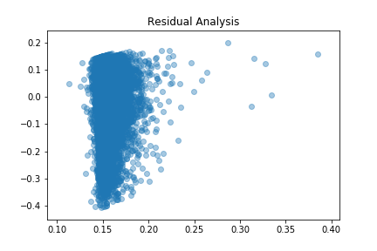
5. Regression analysis (2)
Adding in word count and essay length to data set, regression took 0.76 seconds to run, with coefficient of [-0.309 -0.111 1.63-0.909], train score of: 1.17 and test score of 1.14

Slide 14
5. Regression analysis (3)
Using KNN analysis. I looked at the question both ways to see what would produce the better correlation, running:
median frequency of “I” as a tag, and over a range of datasets: including age, frequency of me, word count and essay length
The median frequency use of I being 14
median age as a, and over a range of datasets: including frequency of me, frequency of me, word count and essay length
The median age being 30 (vs average age of 32)
The age predictor yielded scores of 49% to 51% while the “I” predictor yielded scores of 51% to 83.5% as shown overleaf

Slide 15
5. Regression analysis (4)
Using KNN analysis. using median frequency of “I” as a tag, and over a range of datasets as shown below. The best score was 85.6%
Comparison dataset | Score | Time to run model (s) | Regressor Prediction
Age | 50.8% | 0.63 | [0.36301569]
Age and frequency of me | 68.0% | 0.61 | [0.3644493]
Age and word count | 83.9% | 0.17 | [0.3644493]
Age, frequency of me, and word count | 83.9% | 0.49 | [0.57167059]
Age, frequency of me, word count and essay length | 85.6% | 0.57 | [0.79882677]

Slide 16
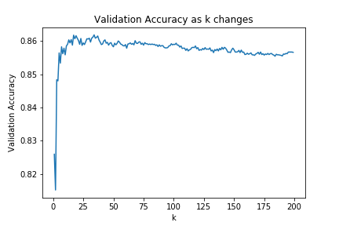
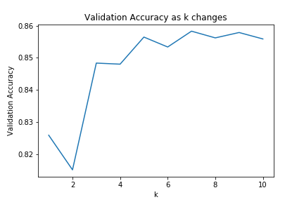
5. Regression approaches (5)
I used k=5 which from the validation accuracy analysis looks about right.

Slide 17
5. Regression Analysis(6)
Comparing the two classification methodologies for predicting age using frequency of “I” in combined essays :
 | Linear Regression | KNN Regression
Simplicity | Equal work needed on preparing dataset | Equal work needed on preparing dataset
Best time (s) | 0.66 | 0.48
Best score | 49.32% | 83.5%
Predictability | Couldn’t test | Not all test parameters worked
Conclusion | Needs very structured entry datasets to be meaningful | Easier to use with less structured datasets and faster

Slide 18
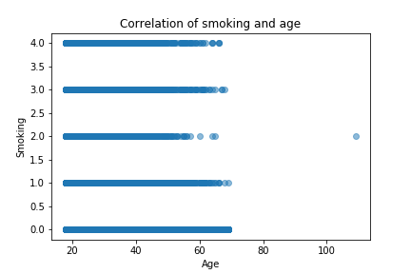
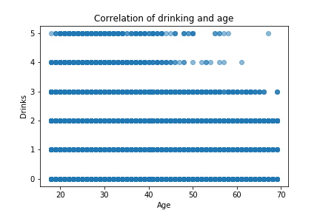
6. Further Analysis (1)
Used KMeans Clustering to analyse impact of age, drink, smokes, drugs. First analysed the data in simple scatter charts versus age

Slide 19
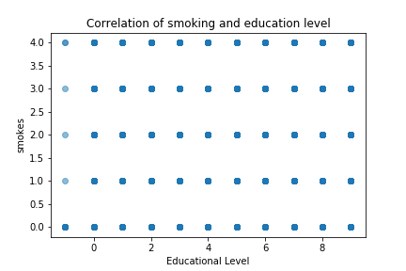
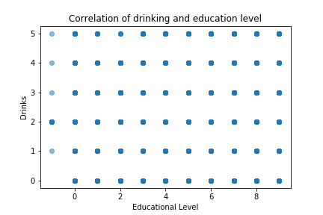
6. Further Analysis (2)
Then in simple scatter charts versus education level

Slide 20
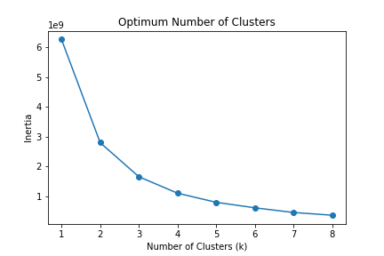
6. KMeans Clustering(3)
I checked for the optimum number of clusters, which was three.

Slide 21
6. KMeans Clustering(3)
Based on a subset of [“drinks_code", "smokes_code", "drugs_code", 'word_count‘] the n adding age and income, I got very clear clusters, especially when adjusted income (although this could reflect the limited income data)
 | Base sample | Adjusted for age | Adjusted for income
Cluster one | Men: 60% Women: 40% | Men: 57% Women: 43% | Men: 57% Women: 43%
Cluster two | Men: 57% Women: 43% | Men: 60% Women: 40% | Men: 77% Women: 23%
Cluster three | Men: 62% Women: 38% | Men: 62% Women: 38% | Men: 77% Women: 23%

Slide 22
6. KMeans Clustering(4)
Using a subset of drinks_code, smokes_code, drugs_code, word count, age and income, we also get clear clusters across jobs, where:
 | Cluster one | Cluster two | Cluster three
Top 5 highest categories | other: 14% student: 10% science / tech / engineering : 8% sales / marketing / biz dev : 7% artistic / musical / writer 7% | artistic / musical / writer 19% other: 13% student: 11% computer / hardware / software : 6% hospitality / travel: 7% | computer / hardware / software 16% science / tech / engineering : 13% sales / marketing / biz dev : 9% other : 9% executive / management : 8%
Top 4 lowest categories | military 0.7% rather not say 0. 6% retired 0.3% unemployed 0.0% | transportation 0.9% unemployed 0.9% clerical / administrative 0.9% military 0.6% | transportation 0.7% unemployed 0.6% retired 0.5% military 0.4%

Slide 23
7. Conclusion / Next Steps
First question: a can we use word count to check education level:
I would say the analysis shows that the correlation isn’t conclusive enough and therefore the question would have to be further refined looking perhaps in more detail within the given dataset, starting with Kmeans which seems a very powerful tool for investigation
Second question: can we predict age based on frequency of usage of “I” or “me”
Yes and worked with both regression metrics , although KNN yielded better results
In terms of next steps, first would iterate through other data such as the details in the essays especially the first three to see if data could be extracted to establish better correlations on age

Slide 24
Back-up
Education
Jobs

Slide 25
A. Education
graduated from college/university 23959
graduated from masters program 8961
working on college/university 5712
working on masters program 1683
graduated from two-year college 1531
graduated from high school 1428
graduated from ph.d program 1272
graduated from law school 1122
working on two-year college 1074
dropped out of college/university 995
working on ph.d program 983
college/university 801 graduated from space camp 657 dropped out of space camp 523 graduated from med school 446 working on space camp 445 working on law school 269 two-year college 222 working on med school 212 dropped out of two-year college 191 dropped out of masters program 140 masters program 136 dropped out of ph.d program 127 dropped out of high school 102 high school 96 working on high school 87 space camp 58 ph.d program 26 law school 19 dropped out of law school 18 dropped out of med school 12 med school 11

Slide 26
B. Jobs
other 7589
student 4882
science / tech / engineering 4848
computer / hardware / software 4709
artistic / musical / writer 4439
sales / marketing / biz dev 4391
medicine / health 3680
education / academia 3513
executive / management 2373
banking / financial / real estate 2266
entertainment / media 2250
law / legal services 1381
hospitality / travel 1364
construction / craftsmanship 1021
clerical / administrative 805
political / government 708
rather not say 436
transportation 366
unemployed 273
retired 250
military 204

